Slide 1

Strategic Communication and Negotiations
Eric Eisenberg, Ph.D.
Lt. General Martin Steele (retired)
Adib Farhadi, Ph.D.
University of South Florida
September 28-29 2016
United States Special Operations Command

Slide 2
Welcome and Introductions
Introduction of instructors and special guests
Perspective on communication of SOCOMM leadership
Why are we here? Goal of this two-day course:
To build greater awareness and personal capacity for using strategic communication to build stronger relationships and accomplish your objectives
To better understand how to apply principles of strategic communication and negotiation to practical challenges that you encounter in your work
Notes:
Learning environment and format:
Lecture and workshop
Learning by doing – examples and experiences
Active participation and reflection as learning method
’Rules for growing and learning’
Participate - be active and share – and it’s OK to ’fold’ (observe)
A confident room and a punishment free zone
We are different – and it is....

Slide 3
Technical Brilliance Is Never Enough!
Emotional intelligence and interpersonal skill are the key differentiators for leadership success
Strategic communication is invaluable: The ability to not just say whatever is on your mind but rather to make conscious communicative choices based upon your particular goals and a deep understanding of the situation and of your audiences.

Slide 4
Learning Objectives
Better understand your communication style
Define strategic communication as a unique approach
Learn how to build successful collaborative relationships
To increase cross-culture competence to effectively communicate and negotiate with organizations and people from diverse cultural backgrounds;
Identify cross-cultural challenges that can arise in negotiations
apply standard concepts from negotiation analysis to empirical cases
Learn how to choose and apply negotiating tools
Notes:
Get the participants to feel comfortable and start talking immediately in their table. If the class is big then just tell them to introduce themselves in the table if the class is small then have everyone introduce themselves.
Start managing expectations early
Write Down the top 3 things they want to learn in the flip chart
Write Down what would delight them
Start explaining the Learning Outcomes of the course leading to the Agenda Slides

Slide 5
Getting Started
At your tables, please introduce yourself and discuss:
What is the most significant communication challenge you have faced so far in your career?
What would you most like to learn about strategic communication and negotiations in this workshop? How is strategic communication most relevant to success in your role?

Slide 6
Agenda
Day One: Strategic Communication
8:30-9:15 Welcome and introductions, getting started
9:15-10:00 What is strategic communication?
10:00-10:15 Break
10:15-12:00 Understanding your communication style
12:00-1:00 Lunch
1:00-2:30 Collaborating across differences
2:30-2:45 Break
2:45-4:00 Promoting positive dialogue
4:00-4:30 Reflections on days learnings, preview of Day Two

Slide 7
What is Strategic Communication?
Communication is a learned skill like tennis or scuba
Communication skill is key to effective leadership, influence and reform
More negative things happen due to poor communication than practically anything else in complex social systems (e.g., natural hazards, medical error)
Systems thinking and conscious communication are the two abilities that separate the good from the great
Expressives, automatics, and conscious communicators
Not all communication is strategic
Think of the best communicator you have ever known. What did they do or say that made them so good?

Slide 8
Strategic Communication Supports Organizational Interests
Fundamentals
Strategic communication should be help support larger organizational objectives.
Each individual strategic communications action is connected to relationships and larger organizational objectives.
Failure to understand the bigger picture can be harmful to an organization.
Why is strategic communication crucial for SOF?

Slide 9
The APT Model of Strategic Communication
A Ask yourself honestly how you are already communicating
P Pause and consider your audience and your goals before communicating
T Take steps to solicit honest feedback about how your communication is perceived

Slide 10
Ask Yourself
A Ask yourself honestly how you are already communicating
Hold up the mirror
Maximize self-awareness about how you are typically seen
Identify patterns in words, gestures, and tone.
Ask trusted colleagues how they perceive you as a communicator

Slide 11
Pause and Consider Your Audience and Your Goal
P Pause and consider your audience and your goals before communicating
Who is your primary audience, and what is their world view? How will they take your message?
Who are other potential audiences you may not intend to reach but who may be exposed to your communication
Is there a purpose for communicating? If so, what is the purpose?

Slide 12
Take Steps to Solicit Feedback
T Take steps to solicit honest feedback about how their communication is perceived
Observe naturally occurring reactions, responses, feedback
Solicit honest feedback
Calibrate the extent to which the feedback is an indication of communication success or failure
Use feedback to incrementally improve communication, in the moment—real time

Slide 13
Know your audiences
Fundamentals
Who do you need to communicate with to achieve your objective?
Who influences who?
What do you want them to do?
What do they know about your issues?
Are they interested in your issues?
What are the best ways to reach them?

Slide 14





















Where your strategic communication happen . . .
Application
Embassies, Agencies, Foreign Ministries
1
1
TOP FORMAL/CONTRACT SOCIETY
SECURITY
ECON DEV
GOVERNANCE
2
2
TRUST GAP
District Centers, Forign Military
CAPACITY GAP
Headquarters, Regional Consulates
3
SECURITY
Villages, Neighborhoods, Firebases, Development Sites
PARTICIPATORY ECON DEV
DISPUTE
RESOLUTION
BOTTOM INFORMAL/STATUS SOCIETY
3

Slide 15
Strategic communications – Challenges
Application
You are dealing with complex issues that your leaders want solved
You have limited authority, resources and knowledge (at your level) toward addressing these big problems
Trust-depleted, environments are your domain.
You are often a “guest in someone else’s headquarters, agency, functional or
geographic domain
You are face to face with diverse cultures and disciplines, replete with pre-
existing biases toward you, and you toward them
Square peg in a round hole – You are right in the middle of inter-state foreign policy initiatives clashing against intra-state, clan realities
You must endure an operational tempo that drives you toward reactionary behavior

Slide 16
The Physical Metaphor
Pass things around the room counting the number of times something is dropped.
What are some parallels between passing objects and passing information, and expectations?
When have you “dropped the baton” and what could you have done differently?

Slide 17
Key Point
In communication, the only message that matters is the one that is received.
Requires:
Real time monitoring/feedback
Respect for message and person
Considerable practice, does not come naturally to most people
Refocusing one’s communication goal from message delivery to “evidence” of grasping

Slide 18
Understanding Your Communication Style
First and most important challenge is to develop a deep appreciation for the uniqueness of your own perceptions, your specific temperament and world view
Seeing yourself as others see you is a huge challenge
In the U.S., ALL attempts to improve communication among people of different races must begin with helping Caucasians to understand that they have ethnicity
The fundamental communication problem is the belief that one’s perceived reality is THE only reality

Slide 19
You Must First Empty Your Cup
A university professor went to visit a famous Zen master. While the master quietly served tea, the professor talked about Zen.
The master poured the visitor’s cup to the brim, and then kept pouring. The professor watched the overflowing cup until he could no longer restrain himself.
“It’s overfull! No more will go in!” the professor blurted. “You are like this cup,” the master replied, “How can I show you Zen unless you first empty your cup.”

Slide 20
Ask yourself…
How am I ALREADY communicating?
Where do I get my data about this?
How can I get more?

Slide 21
Collaborating across differences
How observant are you???
Look very closely at this video clip
http://www.youtube.com/watch?v=vJG698U2Mvo
Count EXACTLY how many times the people in white shirts successfully pass the basketball--Dribbling is not passing
What does this video tell you about the partial nature of perception? About the possibility of collaborating with others?

Slide 22
Collaborating across differences
Once you understand your own world view, you need to develop a deeper appreciation of others’ perceptions
Peoples’ communication styles tend to vary across two primary dimensions
Extraversion vs. introversion
Focus on task vs. focus on people
Influenced but not determined by culture
What has been your experience with “type” analysis (DISC, Myers-Briggs, etc.?)

Slide 23
Fast Pace, Think Out Loud
Action, Big Picture
Moderate Pace, Think Internally
Planning, Details

Slide 24
Task
Results
Bottom Line
People
Process
Relationships

Slide 25
Fast Pace, Think Out Loud
Action, Big Picture
red
Direct & Decisive (Driver)
yellow
Outgoing & Optimistic
(Expressive)
Task
Results
Bottom Line
People
Process
Relationships
blue:
Logical & Precise
(Analytical)
green
Consistent & Supportive
(Amiable)
Moderate Pace, Think Internally
Planning, Details

Slide 26
Leadership Priorities
Results Action
People
Ideas
Process/Plan
Cooperation
Quality Excellence
Drive
Goal orientation
Directness
Speed
Decisiveness
Creativity
Vision/Big picture
Possibilities
Motivated people
Fun/Enthusiasm
Teamwork
Collaboration
Respect/Tact
Quality process
Preparation
Accuracy
Thoroughness
Completion
Analysis/Logic
Fairness
RED YELLOW GREEN BLUE

Slide 27
Collaborating across differences
Strength: Something you do well or easily
Blind spot: A strength that is overused
Confidence overused becomes arrogance
Decisiveness overused becomes controlling
Accommodating overused becomes passive
Are you aware of your blind spots? If so, what do you do to about them when relating to others?

Slide 28
Fast Pace, Think Out Loud
Action, Big Picture
Potential Blindspots:
Unrealistic ideas
Attention-seeking
Lack follow-through
Over-expressive
Overlook details
Easily bored
Potential Blindspots:
Over-controlling
Domineering
Defensive
Blunt/insensitive
Inflexible
Arrogant
Potential Strengths:
Results focused
Direct & Decisive
Get things started
Take risks
Challenge status quo
Driven to achieve
Confident
Potential Strengths:
See the big picture
Creative
Motivate & inspire
Optimistic & enthusiastic
See new possibilities
Personable
Persuasive
RED
YELLOW
Task
Results
Bottom Line
People
Process
Relationships
Potential Strengths:
Quality oriented
Detail focused
High standards
Well organized
Analytical/Logical
Diplomatic
Fair & Just
Potential Strengths:
Easy going
See multiple viewpoints
Calming influence
Supportive
Good listener
Careful and prepared
Reliable
BLUE
GREEN
Potential Blindspots:
Over analyze
Lost in detail
Unrealistic standards
Overly critical
Need to be right
Aloof
Potential Blindspots:
Too accommodating
Overly passive
Resist change
Slow to start
Indecisive
Avoid risk & conflict
Moderate Pace, Think Internally
Planning, Details

Slide 29
Understanding Your Communication Style
Summary:
There is no one right or best style
Understanding your current style as others see it is a precondition for learning anything new
If you are unaware of your blind spots, you are the only one!
Adapt and connect to others’ preferences to the degree that you can
Avoid the cycle of withdrawal and resentment that accompanies misunderstandings over time

Slide 30
Cool Bummer Activity

Slide 31
Lunch

Slide 32

Fostering dialogue: The Nuts and Bolts
Dialogue versus discussion
All of us is smarter than any one of us
The blind men and the elephant
Bruce comes to class
The “three faces of Bill”
Learning by expanding

Slide 33

Leadership is distributed in all living systems!
Flocks and boids
Power rangers and viruses
Neural networks in AI
The orchestra conductor

Slide 34
Fostering dialogue
Use inquiry to continually invite others to share the reasoning for their conclusions
If you offer a conclusion or belief, add how you came to that conclusion
You can find common ground only if you back down the ladder of inference from conclusions to experience
Encourage everyone to speak in terms of their personal experience, and you do it too
Not “unilateral interventions don’t work” but “in my experience, unilateral interventions have not had the impact that I would have expected.”

Slide 35
Fostering dialogue
Discuss in Pairs:
How can we construct and sustain a communicative climate where multiple perspectives are encouraged, even if they are at odds with one another?
In your experience, what behaviors build positive energy, spontaneity, and trust?
What behaviors build negative energy and tentativeness?

Slide 36
Fostering dialogue
What are some ways that you have found to promote dialogue?
Stop talking. Wait. You may be surprised by the good ideas others have if you wait long enough
Limit psychological and physical noise
Make your thinking visible
Suspend judgment. Try to see things from someone else’s perspective.
If you are puzzled by another’s position, sincerely ask for their reasoning which will reveal their interests and create the possibility of common ground. If others seem puzzled by you, share your own reasoning. You can’t argue conclusions.

Slide 37
Fostering dialogue
What are some ways that you have found to promote dialogue?
Ask questions, don’t make pronouncements
When things get sticky, go slow. Don’t rush things just to lower the anxiety level, you may miss out on an important lesson.
Don’t see every talk turn as a chance to either agree or disagree. Use “and” not “but.” Use phrases like:
I have a different perspective
I see the situation differently
I have an alternate view

Slide 38
Fostering dialogue
Or say this…
“Here’s what I know about the situation”
“These are the criteria I used”
“This is the logic I employed to arrive at this recommendation”
“Here are some reasons that, for me, make this the best way to go”
“Let’s look at the data I used to support my decision”

Slide 39
Fostering dialogue
And while you’re at it...
“I don’t have a complete understanding of the situation”
“I may have made a bad call here”
“I can’t answer that question, I just don’t know”
“I am not an expert in that area”
“I may not know enough yet to answer”

Slide 40
Application Issues
How does media choice matter in strategic communication effectiveness?
How does strategic communication differ in times of crisis?
What is rapport and why does it matter? In general, how does the quality of relationships shape the communication process?

Slide 41
Self-awareness and vulnerability
While self-awareness, humility, and vulnerability are the hallmarks of effective, emotionally intelligent communicators, these behaviors must be deployed in the context of unequal power relationships
Environmental debates about rising sea levels endangering Bangladesh and the pros and cons of “coming to the table”
What are some examples of how good communication practices must be modified to take into account existing power relationships?

Slide 42
Self-awareness and vulnerability
Remember:
The more successful you have been in your career, the less motivated you will be to change
Intelligence, leadership, and communication ability are only weakly correlated
More about discipline and commitment than insight
The only message that matters is the one that is received
The only thing you can control is your own behavior
If you do not know your weaknesses as a communicator, you are the only one
Understanding your current communication style as others see it is a precondition for learning anything new—you must “empty the cup!”

Slide 43
Agenda
Day 2: Strategic Negotiations
8:30-9:00 Welcome back, nuggets from yesterday
9:00-10:00 The process of strategic negotiations - basic concepts, techniques and types of negotiations
10:00-10:15 Break
10:15-12:00 Cross-Cultural Negotiations - developing cross-culture competences
Conflict resolution, alternative dispute resolution an peacebuilding
12:00-1:00 Lunch
1:00-2:30 Case Scenario: Village Stability Operations
2:30-2:45 Break
2:45-4:00 Using cultural intelligence to address difficult situations
4:00-4:30 Takeaways, principles for practice
Notes:
Attention will be paid to understanding what negotiations are, how they are conducted in different settings (e.g. government, private sector, not for profit world), and how negotiations can be understood under the broader rubric of communications
The role of culture in communication will be explored, including the manner in which cultures have an impact on negotiating style and substance and the limits of culture as an explanatory variable
We will focus here on Afghanistan, US’s longest war to better understand the complex negotiations. The role of culture and history will be explored in trying to Afghan negotiating behavior. Ritual, tradition, perceptions of the outside world and history will be explored as key factors influencing Afghan negotiating behavior. The Afghan case will be explored in depth; other cases will be surveyed as well.
Mediating cultural factors such as religion, tribe, social class, gender, conflict and history will be explored in depth, as these and other qualities are central features of negotiating behavior in the Middle East, Central Asia and Africa.
The United States when viewed from outside the country has distinctive cultural factors influencing the conduct of negotiations. These will be explored in depth from the perspective of non-Americans conducting negotiations with the United States.
This course will provide a methodological and practical insights into cross-cultural negotiation.

Slide 44
Strategic Negotiations
Arrive at an agreed outcome
Where parties are not in complete accord to begin with!
Communication is the key to trust and relationship building
Strategic Negotiation is about influence not control
Globalization has increased international cross-cultural negotiations
Conflicts and instability has increased the need for conflict resolution
Notes:
Strategies are the pre-formulated game plans, objectives, and approaches that guide negotiators in reaching their goals;
Tactics are the specific ways bargainers implement these strategies.
From Strategy of Conflict by Schelling
Give examples of why to negotiate and the cost or result of not negotiating

Slide 45
What is a successful negotiation?
What factors determine the success of negotiations?
What are the reasons for negotiating?
What are the main issues in this negotiation?
What are the interests of the participants?
What is a good negotiating strategy?
What do we know about the other party?
Notes:
Being clear about reasons for negotiating
Learning about the other party
Motivations; Structure; Principles of Action; Interests; Constituency; Needs; Cultural and Ethnic Dimensions; Control of Population and Territory
Two or more parties are involved.
There exists a perceived conflict of interest between those parties.
Parties chose to negotiate because they believe they can influence each other to get a better deal than what they would otherwise get if action was unilateral.
For time being, parties prefer to work together for resolution rather than fight or seek other non-negotiated remedies.
Parties expect to experience “give and take” during their negotiations as each side compromises positions.
Parties expect that negotiations will allow them to manage both the “tangibles” and the “intangibles” contained in their issues.

Slide 46
What are some barriers to successful negotiations
Parties may not be open about their desired outcomes.
Parties may not be clear about what they actually want to accomplish.
Parties may not reveal all of the truth regarding their positions to each other or may not trust the other party.
Parties may not have the right negotiators.
Parties may not be ready to settle.
Notes:
Assumptions
For me to win, you must lose: therefore, we must compete
To help you is a sign of my weakness and it will hurt me: therefore, little real communication
My power comes from opposing, criticizing and beating you: therefore, parties are more rigid
Outcomes
One-sided victories (Win-Lose)
Split-the-difference compromise
Escalation into conflict
Costs high to both parties
Neither party fully achieves goals
May lead to decay and decline of both parties

Slide 47
How do cross-culture negotiation differ from traditional negotiations
Misunderstandings occur more often
We make general categorizations about the other party
When we feel our values are threathened we get upset
Understanding characteristics of the issues, parties, negotiating environment and setting
Challenges of International Negotiations
“western negotiations style vs non-Western style”
“it’s only business” vs “everything is personal”
Notes:
What issues are most important to your opponent? How does your opponent value them?
Negotiating across national and cultural boundaries raises additional challenges for participants. All of us are a product of the culture and geographical areas in which we were raised and now live. Culture creates biases in our perceptions, motivations, interests, and strategies, which may give rise to a host of conflicts in the negotiating process. Aspects of culture that may affect negotiations include such things as language, dialect, societal norms, business etiquette, religion, values, cuisine, hygiene, comfort, and personal preferences. International negotiations are also often impacted by historical events, nationalism, legal restrictions, tariffs, geographic distance, topographic conditions, multilateral alliances, and political conflicts.

Slide 48
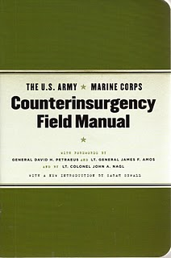
What is culture?
“System of shared beliefs, values, customs, behaviors, and artifacts that members of a society use to cope with their world and with one another.”
”Culture (is) those deep, common, unstated experiences which members of a given culture share, which they communicate without knowing, and which form the backdrop against which all other events are jugded. ”
(E. T Hall in Rogers & Steinfatt, 1999

Slide 49
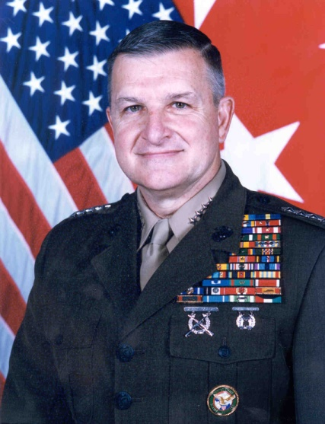
Why Understanding Culture Matters
“You have to understand the culture you’re getting involved in. We never do a good job of cultural intelligence,…of understanding what makes people tick, what their structure is, where authority lies. Cultural bias limits our ability to understand what is going on around us.”
Gen. (Ret’d.) USMC Anthony Zinni
Former Commander, CENTCOM

Slide 50
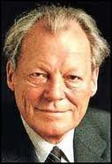
The importance of communication - language
"If I'm selling to you, I speak your language.
If I'm buying, dann mussen Sie
Deutsch sprechen"
Willy Brandt, former German Chancellor

Slide 51
Why is cross-cultural negotiations difficult?
Please take 5 minutes to identify 5 most important challenges to international cross-cultural negotiation
Added complexity and challenge
Substantial extra time and effort required
Culture shock
Barriers and obstacles
Need for translators
Notes:
Barriers and Obstacles:
Miscommunication due to language
Time limitations
Cultural differences
Limited authority of international negotiators

Slide 52
Terms Used in Negotiation
BATNA (best alternative to a negotiated agreement)
Power vs. Rights
Positions
Interests
Needs vs. Wants
Relationships between people, not just organizations
Persuasion
Negotiation skills can be honed and practiced
Notes:
BATNA: Bottom line or reservation point
Need to ensure that a negotiator’s BATNA is never revealed to the other party
Position: A negotiator’s opening offer
Represents the optimistic or target value of the issues being negotiated
The stated demand at the negotiation table
Interests: The unspoken motivation or reason that underlies any given position
Unlikely to be expressly stated or acknowledged during the negotiation
May be personal or cultural in nature
Interests will be the key driver in cross-cultural negotiations. We will focus on interests.
Needs: those negotiated outcomes that the negotiator must have in order to reach a successful conclusion
Wants: those negotiated outcomes that a negotiator would like to have
May often be exchanged as concessions

Slide 53
BATNA Concept
Best Alternative to Negotiated Agreement (BATNA): result of walking away from negotiation
Never reveal your BATNA
What is your BATNA

Slide 54
BATNA Example

Slide 55
Power vs. Rights
Power is the ability to direct the outcome of negotiations.
Rights is the entitlement to a negotiating outcome.
Notes:
Power:
Difficult to determine who is more powerful without a destructive power contest
Perception of other party’s power often incorrect
Other party may respond irrationally
Rights
Rarely clear answer
Two rights sometimes contradictory
Advocating rights is frequently costly and time consuming
Rights assertion frequently requires intervention by a third party

Slide 56
Positions
A negotiator’s opening offer
Positional Negotiations
Negotiate to win!
Short-term or One-time issue
Relies on power to force acceptance of a position
Notes:
Positional Negotiations Attitudes:
Resolution options are limited
We are adversaries
There is only one right solution – Mine
Be aggressive to win
Any concession is a sign of weakness
Negotiate to win all you can
A win for you is a lose for me

Slide 57
Interests
The unspoken motivation or reason that underlies any given position
Concern needs, desires, concerns, fears, values, or matters that a party really cares about

Slide 58
Needs vs. Wants
Needs – those negotiated outcomes that the negotiator must have in order to reach a successful conclusion
Wants – those negotiated outcomes that a negotiator would like to have

Slide 59
The negotiating process
Outcome
P
R
E
P
A
R
A
T
I
O
N
Negotiations
Combine slides
Notes:
Know Exactly What You Want: Determine and write down specific goals and objectives
Plan for the Negotiation:
Identify participants
Develop objectives
Analyze strengths and weaknesses
Gather information
Recognize other party’s needs
Identify facts and issues
Establish positions
Develop strategies and tactics
Brief personnel
Practice the negotiation
Can be referred during the negotiation
The more clearly defined, the more likely that can be achieved
Know Exactly What You Want: Determine and write down specific goals and objectives
Can be referred during the negotiation
The more clearly defined, the more likely that can be achieved
Propose Action They Can Accept: Frame your own needs in terms of the other party’s needs
Make it easy for the other party to say, “Yes”
Remain fair, flexible, and reasonable

Slide 60
Negotiating Process
Step 3:
Propose Action in a Way that They Can Accept
The Negotiation Process
Step 1:
Know What You Want
Step 2:
Know What They Want

Slide 61

The Iceberg Theory
Iceberg Theory
“Below the line” issues
Huge & invisible.
Purposely hidden, or simply
Out of awareness

Slide 62

Why is negotiations difficult?
ACTION => VISIBLE LEVEL 10 %
REACTION =>
INVISIBLE LEVEL 90%
Norms and rules
Personal experiences
Values
World view and basic assumptions

Slide 63
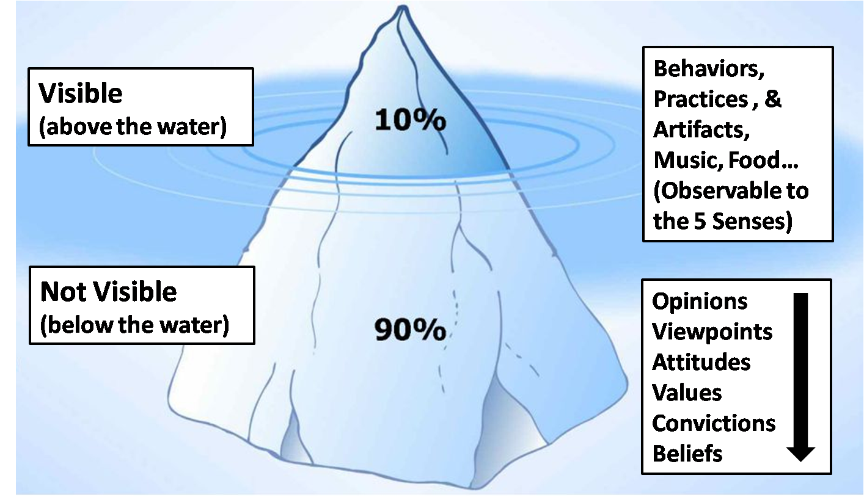
The Cultural Iceberg

Slide 64

THE INTEREST ICEBERG
Remedy Requested
Relationships
Culture
Behaviors
Pride
Bias
Practices
History
Notes:
Explain the centrality of culture in Interest Negotiations
Clarify INTERESTS Not Positions
Ask why?, why not?
Capitalize on joint interests, reconcile differing interests
Look to CRITERIA and creative OPTIONS to deal with conflicting interests
Invent OPTIONS for Mutual Gain
Separate inventing from deciding
Generate options through “brainstorming”
no evaluation, no commitment, no attributions

Slide 65

Strategic communications is looking below the water line
Application

Slide 66



What lies beneath is “gold” for strategic communications
Application
TALKINGPTS
ACHIEVMENT /GUILT
PUNITIVE
JUSTICE
INDIVIDUAL
LOGIC
TRANSACTIONS
BRIDGING TRUST
HONOR/SHAME
RESTORATIVE JUSTICE
EMOTION
CLAN
RELATIONSHIPS
BONDING TRUST
STORY
TRIBAL

Slide 67
What’s beneath your waterline? Group exercise
Application

Slide 68
Cultural Intelligence

Slide 69
High Context and Low Context Cultures
Low Context
Logical, linear, individualistic, and action-oriented
Value logic, facts, and directness
Task more important than relationship
North America and most of Western Europe
High Context
Intuitive, indirect, collectivist, and communication-oriented
Value emotion, circumstances, and subtlety
Relationships more important than task
Most of Middle East, Asia, Africa, and South America

Slide 70
Contrasting Cultural Differences in Negotiation and Mediation
WESTERN | ASIAN
Low Context (direct) Communication | High Context (indirect) Communication
Low Power Distance | High Power Distance
Individualism | Collectivism
Low Uncertainty Avoidance | High Uncertainty Avoidance
Masculinity (Assertive) | Femininity (Cooperative)
Short-Term Orientation | Long-Term Orientation
Monochronic Time | Polychronic Time
Space - far apart | Space – close

Slide 71
Contrasting Cultural Differences in Negotiation and Mediation
WESTERN | ASIAN
Risk Takers | Risk Avoiders
Brief Rapport building time (short) | Extensive Rapport building time (long)
Aggressive | Passive
Contract focus | Relationship focus
Win-lose approach | Win-win approach
Informal approach | Formal approach
Show emotions | Hide emotions
Preference for specific agreement | Preference for general agreement
Contract is fixed | Re-negotiation is possible
Individual Decision-making | Group Decision-making
Logical decision-making | Emotional decision-making
All equals | One leader
Face Saving | Face Giving
Inductive logic | Deductive logic
Low Government involvement | High Government involvement
Linear-Active | Multi-Active | Reactive

Slide 72
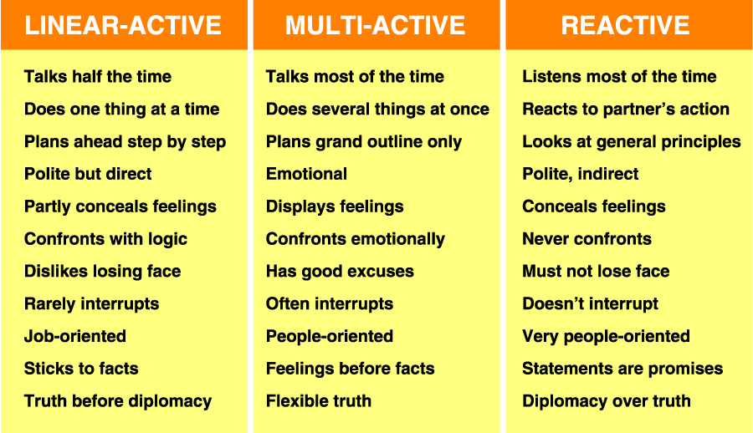
Cultural Categories

Slide 73
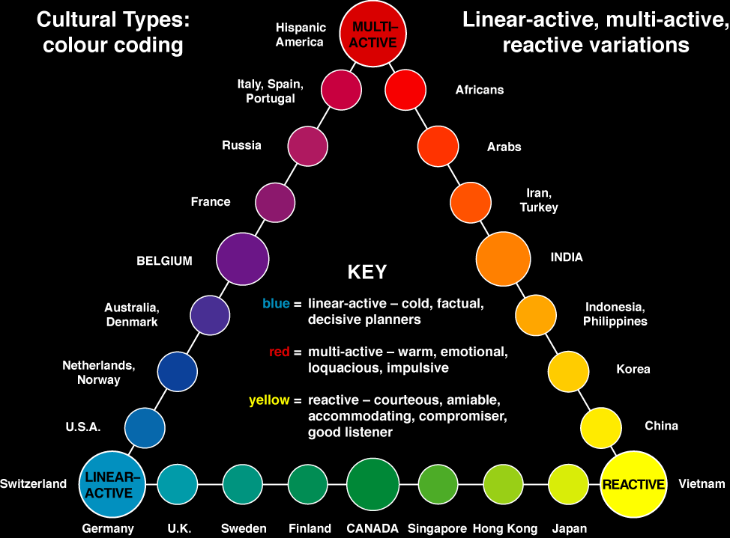
© 2001 Richard D Lewis
Notes:
Give Examples of Middle East and Central Asia and where do they fit in.
Linear-Active
Multi-Active
Reactive
Why are American more Linear-Active?

Slide 74

Afghanistan
The shortest distance between point A and point B is never a straight line

Slide 75
Stages of Culture Shock
Honeymoon
Disorientation
Irritability and hostility
Adjustment and Integration
Biculturality
Parochial stage: differences ignored or found amusing
“I know their way but my way is better”
“I have my way and they have their way”
“Our way”

Slide 76
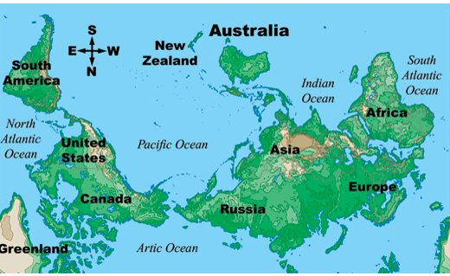
Australian View of the World

Slide 77
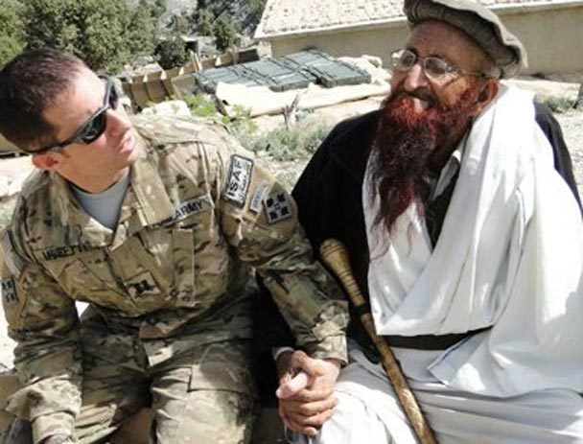
Defining Culture

Slide 78
Cross-Cultural International Negotiations
Defining Culture and Cultural Differences
Culture Shock
Influence of culture in international negotiations
Understanding Different Culture Perspectives:
Cross Culture
Intercultural
Transcultural
Cross-Cultural Communication
Building Trust
International Business Etiquette
“Culture Orientation Model”
10 Dimensions
Identify key cultural dimensions that influence and motivate behavior
Generalizing, Stereotyping and Bias
Recognize signs of stereotyping
Identify common cultural biases and perceptions, and evaluate own cultural biases
Notes:
No one model can explain every cross-cultural negotiation situation – there is simply not the level of knowledge to create such a model, but we will discuss the various negotiating tools that can help. With new technologies these tools are becoming more common.
This can be frustrating for many cross-cultural negotiations but we will discuss some viable tools that can help,
There are tendencies for negotiators to undervalue or overvalue the amount of culture variation. It is important to understand while culture is very important there are clearly other significant factors that will play a role.
It is also important to recognize that even though culture describes group-level characteristics, it does not mean that every member of a culture will share those characteristics equally, and it is very difficult to predict an individual’s behavior on the basis of culture differences alone.
In fact, there is likely to be a wide a variety of behavioral differences within cultures as there is between cultures.

Slide 79
Cross-Cultural International Negotiations vs traditional negotiations
Misunderstandings occur more often
Cross-cultural dynamics: The strange (differences) or the Stranger (the Other) as a phenomena can escalate reactions and tensions
We make categorisations!
When we feel our values are threathened we get upset!

Slide 80
Cultural values and identity
Values are often at stake when cross-cultural encounters turn into cross-cultural conflicts
We are likely to get upset when we feel our values are being challenged, questioned or harasssed!
Beacuse values are part of our identity
What is our cultural identity?

Slide 81
Modern and Traditional Cultures
Task-Oriented
People-Oriented
Results
Individual
Long-Term
Informal
Content
Doing
Free-will
Competition
Process
Context
Group
Being
Present / Past
Style
Present / Future
Substance
Short-Term
Pre-Ordained
Formality
Cooperation
Linear
Cyclical

Slide 82
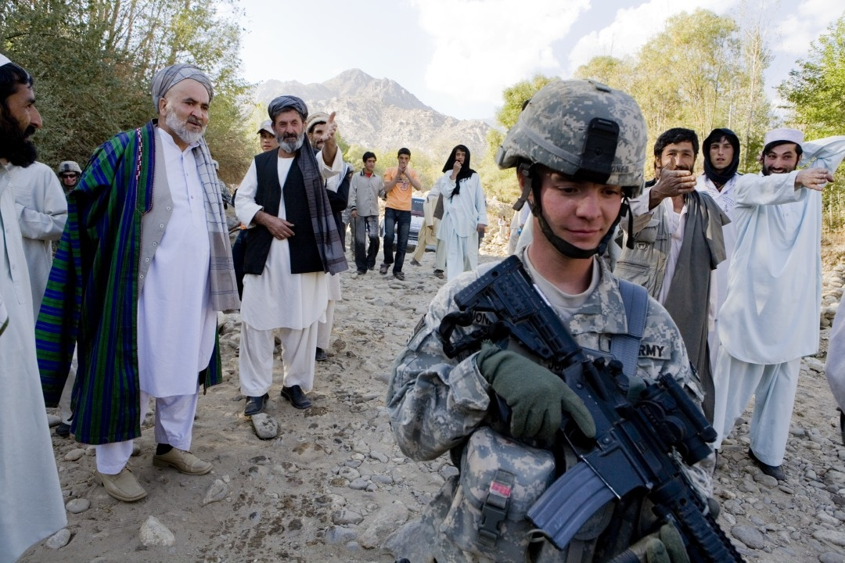
Framework for Understanding Culture
Low vs. High Power Distance
Individualism vs. Collectivism
Masculinity vs. Femininity
Low vs. High Uncertainty Avoidance
Long vs. Short Term Orientation

Slide 83
Cultural Differences Affecting Negotiations
Do not identify the counterpart’s home culture too quickly. Common cues (e.g., name, physical appearance, language, accent, location) may be unreliable.
Beware of the Western bias toward “doing.” Ways of being (e.g., comportment, smell), feeling, thinking, and talking can shape relationships more powerfully than doing.
Counteract the tendency to formulate simple, consistent, stable images.
Do not assume that all aspects of the culture are equally significant.
Recognize that norms for interactions involving outsiders may differ from those for interactions between compatriots.
Do not overestimate your familiarity with your counterpart’s culture.

Slide 84
The Western View of Negotiations
Party A
The Deal
Party B
Notes:
Don’t think that everyone else negotiates like the Americans
There is a danger in stereotyping or oversimplifying characteristics of other cultures
There is always substantial interpersonal variation within any culture
However, there are often common tendencies

Slide 85
The Non-Western View of Negotiations
Trust-based
Relationships
Business bonding
Via
Entertainment
Party A
The Deal
Party B
Contracts based
On a
Handshake
Family/ethnic relationships
Gifts
and
Favors
Notes:
The White
The Black
And
The Gray Zone

Slide 86
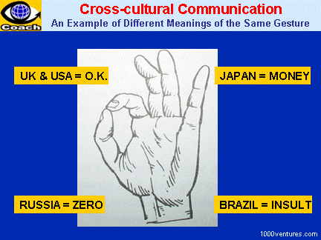

Slide 87
Cultural Intelligence
Concept, stages and process - Development of cross-cultural competences
Country Specific Information
Socio-Economic Issues
Political Issues
History
Cultural Orientation
Religion
Lost in Translation
Technology Factor
Culturally intelligent leadership and team management
Skills and strategies

Slide 88
Explicit and Implicit Communication
High-context/implicit communication cultures
Japanese
Arabs
Latin Americans
Italians
English
French
North Americans
Scandinavians
Germans
Low-context/explicit communication cultures
Swiss Germans
Figure 7–1: Explicit/Implicit Communication: An International Comparison
Notes:
Explain and give Examples of Explicit and Implicit Communications

Slide 89
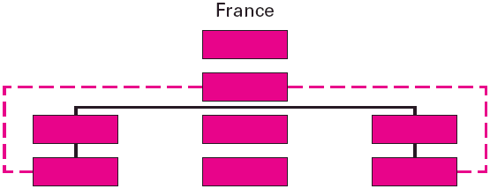
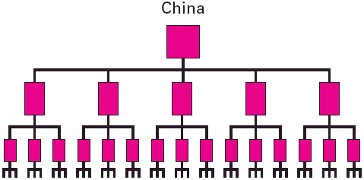
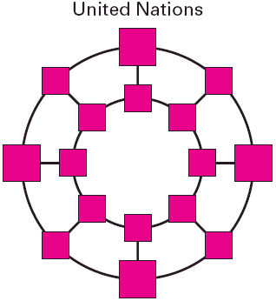
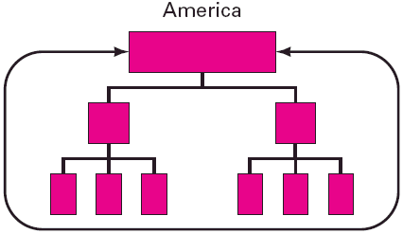
Communication Epigrams

Slide 90
France
Less team oriented – negotiate individual
Debate is stimulating
Well prepared
Parties can make decisions
Strategies include logical proposals, arguments and counter proposals
Preference for discussing philosophy
Important meetings treated very formally

Slide 91
Germany
Well prepared, serious, organized
Tough positional stances
Least affected by interpersonal issues/relations
Negotiations are formal and will follow agenda
Relationships should not intrude on tasks
Low risk takers
Conflict viewed as inadequate preparation
Emotional outbursts and frequent interruptions not appreciated
Decision making takes time

Slide 92
Italy
Personal relationships important
Need to feel they can get along with counterparts
Confident, shrewd and competent
Initial negotiations can include lots of casual talks and positioning tactics
Takes a long time to get to point
Multiple conversations at once and interruptions common
Presentation must be organized, clear and polished with dramatic effect for audience

Slide 93
British
Value bottom line and short term results
Open about opinion but indirect in its expression, emphasizing courtesy and tact and formality.
Don’t show true emotions – often reserved and understated
Risk averse and cautious, favoring security and status quo

Slide 94
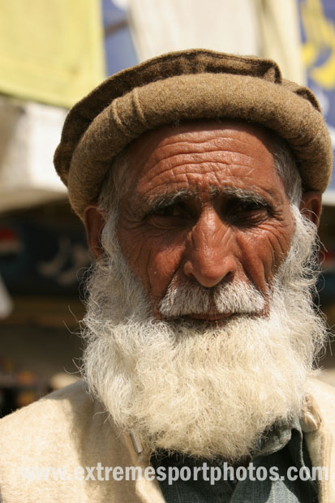
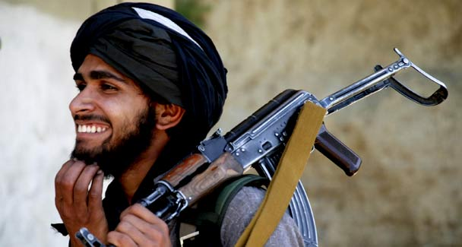
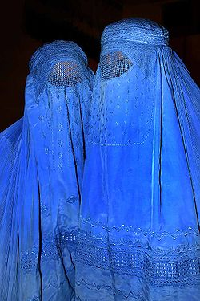


Stereotypes of the Afghanistan-Pakistan Region
??
??

Slide 95
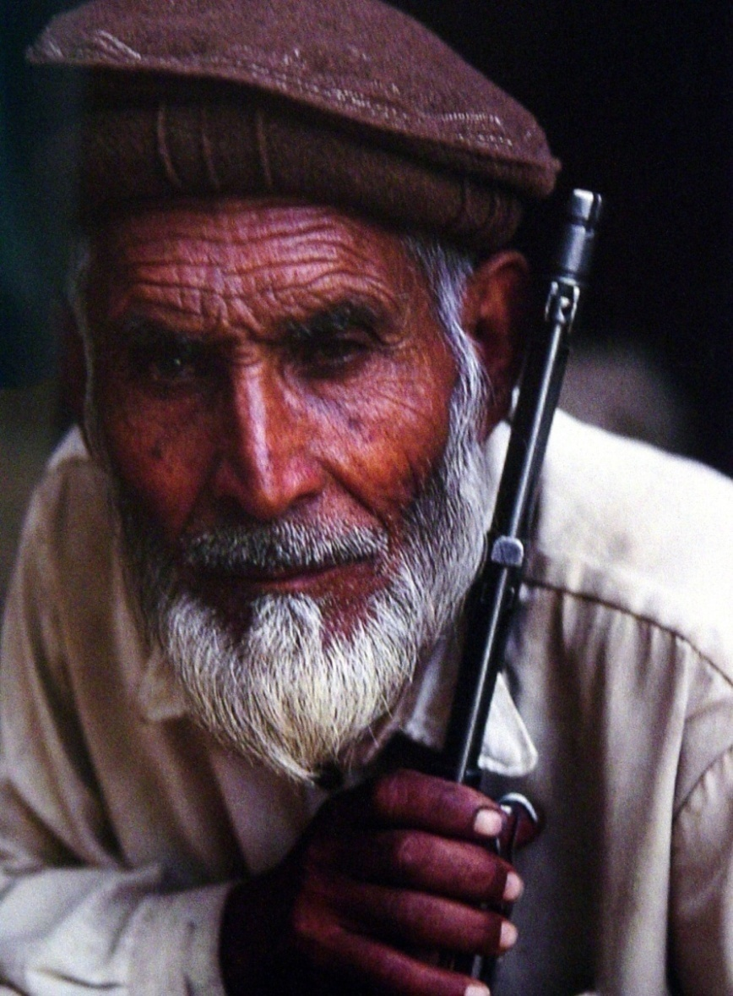
American Stereotypes of Afghans
Negative: Always late; slow to decide/act; authoritarian/corrupt; argumentative; overly sensitive; religiously conservative; misogynists
Positive: Warm and friendly; humble and hospitable; rugged and hardworking

Slide 96
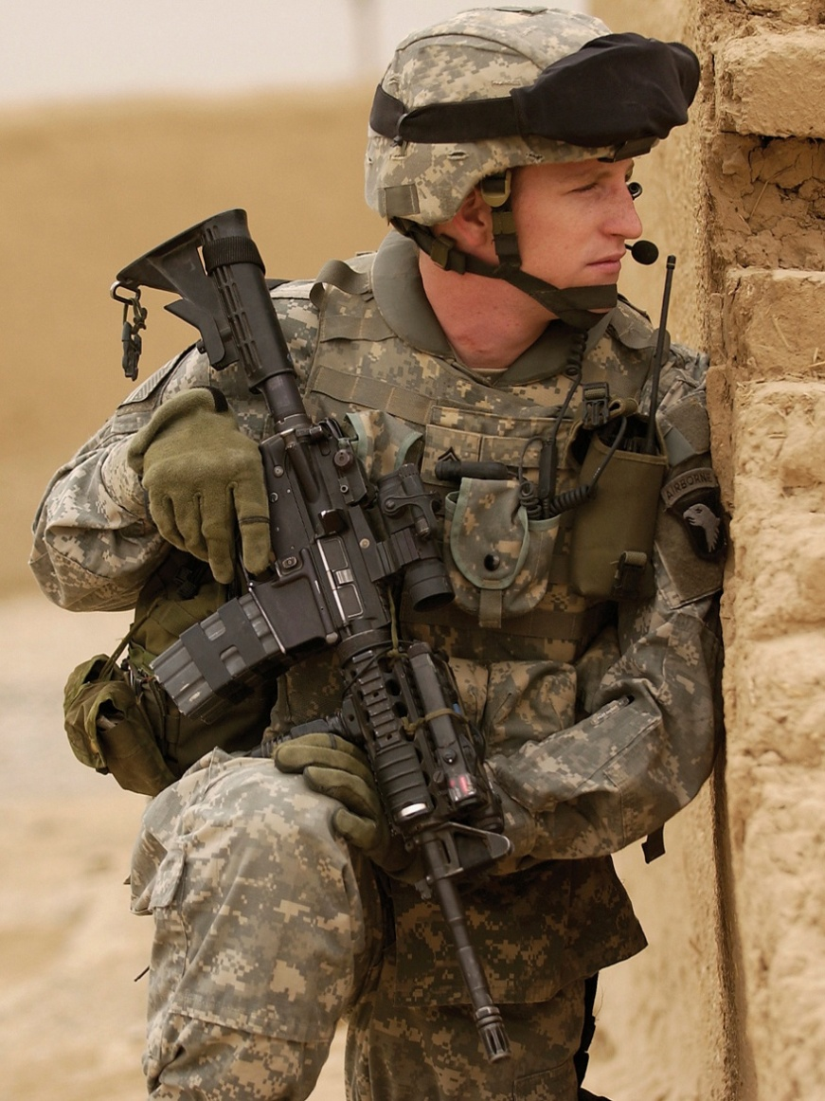
Stereotypes of the American Soldier
Negative: Direct and informal; impatient; spoiled; wasteful; loud; rude; “loose”
Positive: Wealthy; generous; hardworking; optimistic; fun-loving

Slide 97
Common Asian Groupings
High context
Collective
High Power Distance
Long-Term Orientation
Notes:
Power Distance: Extent to which members of a society accept that status and power are distributed unequally in an organization
Organizations in these cultures tend to be autocratic, possess clear status differences and have little employee participation

Slide 98
American Stereotype
Low context
Individualist
Low Power Distance
Short-Term Orientation

Slide 99
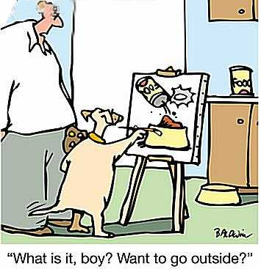
Context of Communication

Slide 100
High Context Communication
Communication is indirect
Meaning is indirect, implied, and derived from the context
Difficult to hear/infer interests
Implied meanings arise from the setting/context
Non-verbals are very important
Lots of inferences need to be drawn
Words promote harmony
Conflict is avoided
Says "No" without using the word "No"
Linked to: Collectivism, Hierarchy, spiral logic

Slide 101
Low Context Communication
Words communicate information directly
Literal meanings independent of setting/context
Meaning is in the words; its clear
“Read my lips"
Conflict is OK
Says "No" easily
Linked to: individualism, Equality, Linear logic

Slide 102
How would you negotiate with High Context Communicators?

Slide 103
Negotiating with High Context Communicators
Read between the lines
Don't take them literally; gather "clues"
Pay close attention to context & non-verbals
Ask for further clarification
Draw out their full ideas with questions
Ask them to be more direct
Face is very important
Don't challenge them; they may lose face
Explain that you do not fully understand;
Take time to build a good relationship

Slide 104
Tips for Low Context Communicators
Read between the lines; be sensitive to the non-verbals; assess the context
Don’t be too direct
Don't overwhelm them; be less aggressive
Soften your words when expressing disagreement
Tone down emotions
Engage in more "small talk"
Build relationships early

Slide 105
How would you negotiate with Low Context Communicators?

Slide 106
Negotiating with Low Context Communicators
Take their words at face value
No need to read between the lines
What you hear, is what you get
Communicate clearly and explicitly. Be "upfront"
Ask direct questions; share frank observations
Say "no" if you mean "no"
Avoid ambiguous expressions
Reframe their directness as helpful information
(not rudeness)
Listen & active listen
Be ready to negotiate at the first meeting
Handle some business over the phone or internet

Slide 107
Tips for High Context Communicators
Don't assume they understand the larger context
Be more direct; don't be ambiguous
Say "no" if you mean "no"
Don't assume they can read your mind
They won't understand the nuances
Be ready to negotiate at the first meeting
Handle some business over the phone or internet
Use less relationship building time

Slide 108
High Power Distance
Lower status people recognize and accept that power is held unequally in society.
Hierarchy & status are very important.
Motto: "Respect for the leader or the elder."

Slide 109
Low Power Distance
A belief that "all people are equal"
Status comes from competence, not age
Very limited rapport-building time

Slide 110
How would you negotiate with High Power Distance Cultures?

Slide 111
Negotiating with High Power Distance Cultures
Understand & defer to their hierarchy
Use titles (don't be informal) & respect authority
Prepare by learning about the position of each person on their team
Match eagles with eagles
Exchange business cards early (Japanese meishi)
Treat them with respect.
Don’t be intimidated by their status
Demonstrate your rank
Privileges are expected by superiors
Blame subordinates
Remember that everyone has their place
Better to be too respectful than to lack it
Don't insist on everyone's input
Expect highly centralized decision making. Authority may be limited

Slide 112
Tips for Low Power Distance Cultures
Have a leader; discover their leader
Respect their superiors, rank, and age
Recognize differences in status
Be extremely respectfully
Summarize after your meeting to assure consensus
Remember your "place" in their eyes
Don't get too close to people with less power
Be more formal
Match their rank with your rank
(Eagles with Eagles)

Slide 113
How would you negotiate with Low Power Distance Cultures?

Slide 114
Negotiating with Low Power Distance
"Just call me John;” be less formal
Titles won’t impress them
Don’t expect the same respect you receive at home (if you are high status)
Address questions to the whole group
Treat them all as equals
Use teamwork
Acknowledge experience & expertise,
not status
Respect individuality
Respect subordinates; ask for their opinions

Slide 115
Tips for High Power Distance Cultures
Do not expect the respect you receive at home
Leave your ego at the door
Respect everyone, regardless of position
Be egalitarian, humble and not condescending
Delegate more
Listen carefully to their subordinates & expect their ' opinions to count
Do not judge the value of their opinions by their status
Accept informality
Learn who has the power to make decisions
Solicit opinions of others, including subordinates
Their lower level people may have more decision making authority than yours
Agree to disagree with subordinates.

Slide 116
Things to Remember
Impossible to cover every aspect of culture
Everyone will have different experiences
There’s often a disconnect between ideal values or norms and actual practice (especially living at subsistence level)
Contradictions and exceptions to every rule and generalization
“Only constant is change,…only absolute is complexity”

Slide 117
Cultural differences between Middle East, Central Asia and South Asia and other countries
Use interest-based bargaining
Behave “win-win”
Try to not be competitive; be caring
They may support your goals (if possible)
“Separate the people from the problem.“
Seek a long-term relationship
Support the relationship
Engage in small talk; active listen them
They will be willing to offer concessions
Be mindful of the emotions involved
Notes:
Explain the difference between countries

Slide 118
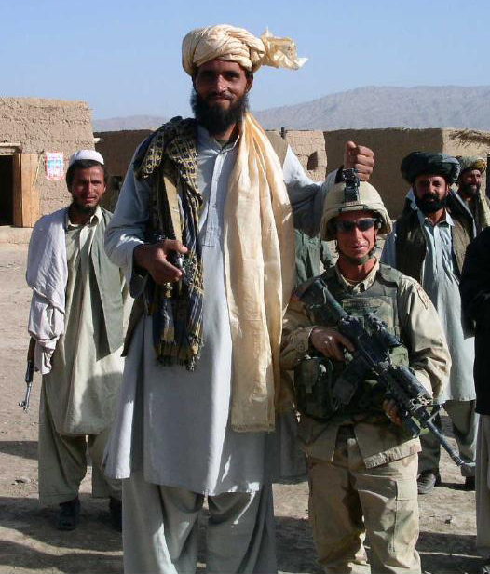
Stereotypes vs. Generalizations

Slide 119
Stereotypes vs. Generalizations
Stereotypes
Can be positive or negative
Usually exaggerated; never moves beyond bias and often based on infrequent interaction
Generalizations
Based on research, surveys, or years of interaction
Less value judgment, more observation or acceptance
What are some common stereotypes of Americans?

Slide 120
Cultural identity exercise
In your table (5min)
Write down the cultures you belong to! (at least three)
Fold the paper, swap with your neighbour
Underline the culture you think is the most important for the other person and strike out the others
Swap back and reflect upon your reactions when striking out – and being striked out

Slide 121
Takeaways
Several factors influence can influence the process of negotiations, and that the influence of these factors can change over time.
The challenge is to understand the simultaneous, multiple influences of several factors on the negotiation process and outcome and to update this understanding regularly as circumstances change.

Slide 122
International Conflict Resolution Negotiations
Intrapersonal conflict
Conflict within the individual
Interpersonal conflict
Conflict among and between individuals
Intragroup conflict
Conflict within a group
Intergroup conflict
Conflict among and between groups
Notes:
Defining Conflict Resolution – the nature of conflict
Understand how culture and religion impacts conflict negotiations
Do cultures approach conflict differently?
Different types of conflict resolution
Interpersonal
Intergroup
International
Military Intervention
Cultural and Religious dimensions of conflict
Tribal and Ethnic conflicts
Nationalism and Patriotism
Role of Civil Society
How do Western mindsets limit their ability to help non-Western countries?

Slide 123
Understanding current international conflicts
Peacebuilding
Peacemaking
Peacekeeping
Peacebuilding
Humanitarian Interventions
Traditional methods of peacebuilding
facilitation,
mediation,
arbitration
international court
reconciliation,
Track II diplomacy

Slide 124
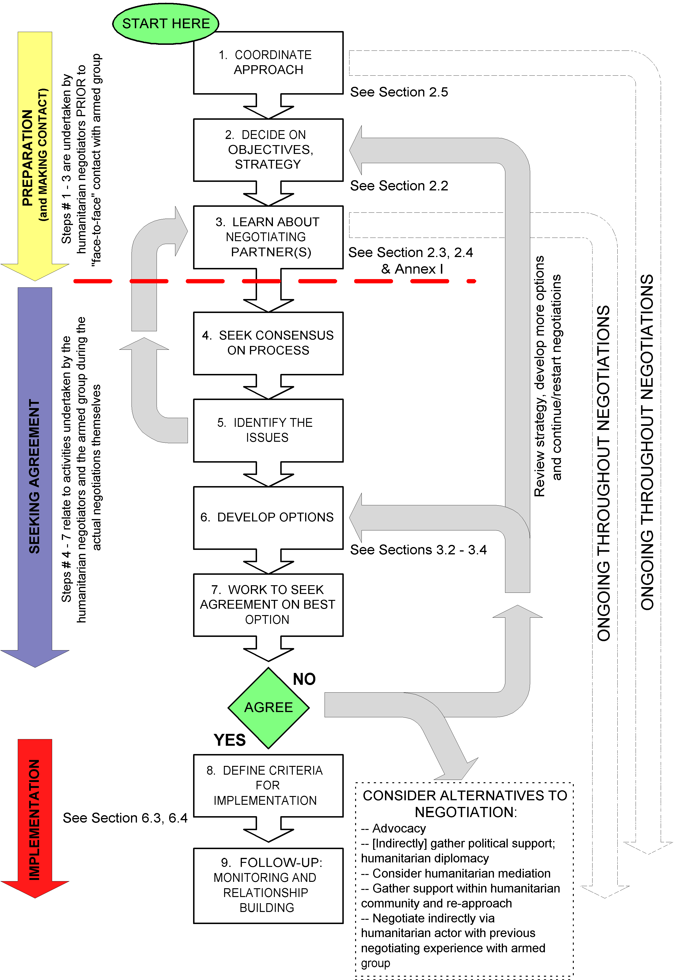
Source: Negotiation Manual Page 51
Notes:
Preparation
Exchanging Information
Opening and Concession Making
Closing and Commitment
Levels of Leadership
Track I: Top-Level Leadership
Track II: Middle-Range Leadership
Track III: Grassroots Leadership

Slide 125
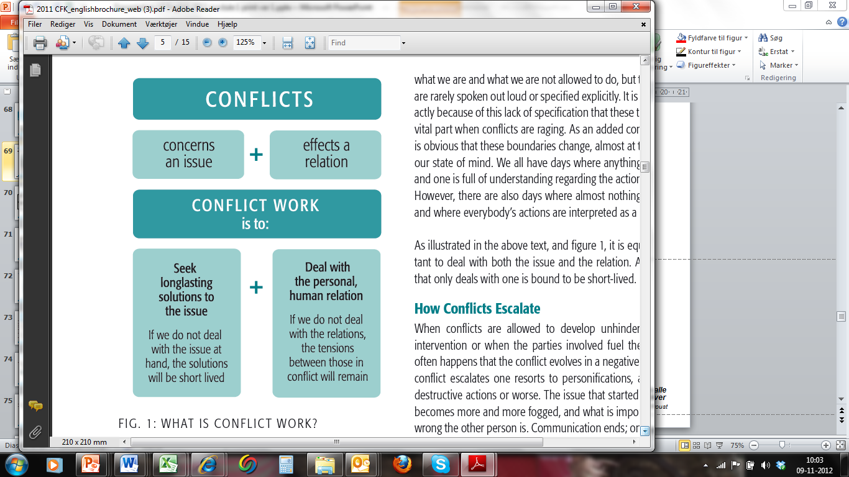
Conflict Resolution Procedures (CPC)

Slide 126
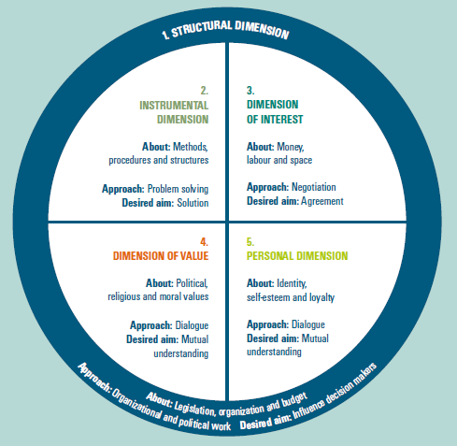
The Five Dimension Model
ISSUE
NEGOTIATION
(DISCUSSION)
DIALOGUE
RELATION
Source: The Danish Centtre for Conflict Resolution

Slide 127
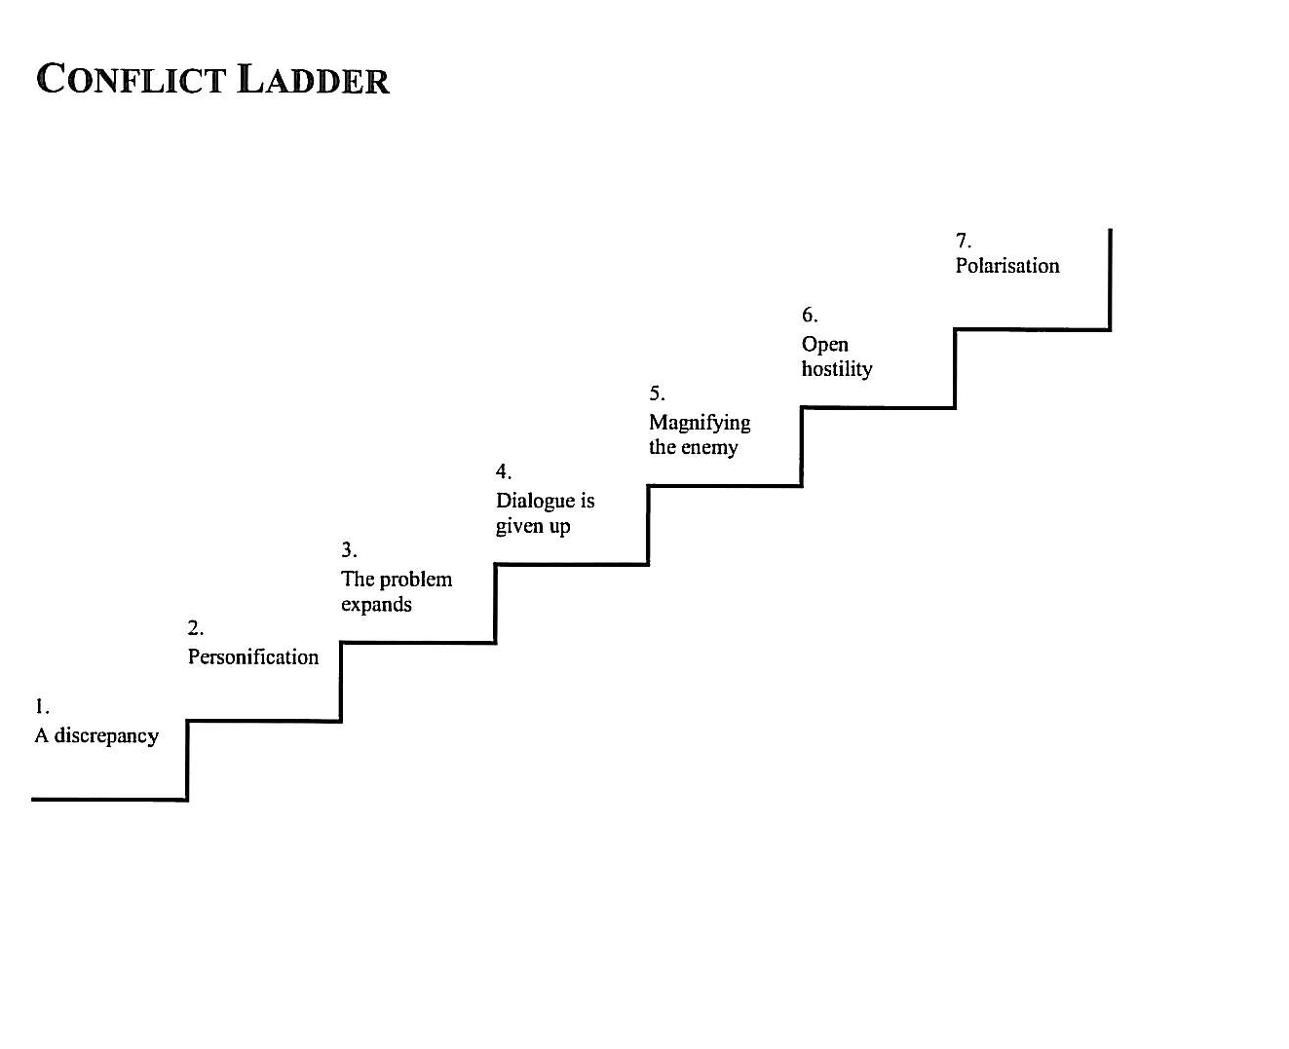
Conflict dynamics - escalation
WARNING!
WARNING!
IF THE CONTACT IS BROKEN => it is no longer possible to manage a conflict through dialogue and negotiation!
Source: The Danish Centtre for Conflict Resolution

Slide 128
Conflict Resolution Procedures Exercises
In your table think of a concrete example of a complex Cross-Cultural and Conflict or a dilemma or a conflict you have experienced lately or you have knowledge of!
Is it an issue or relation oriented conflict?
How do the two sides interact/influence each other?
What is the central point?
Which of the five dimensions is dominant?
On which step of the ladder they are?
How can you open up the communication?
Primarily dialogue or negotiation?
What could be a first step to resolution if any?

Slide 129
Review of Learning Outcomes from Day One 1
Insert Graphics
END DAY ONE

Slide 130
Review of Learning Outcomes from Day One 1
Insert Graphics
START DAY TWO

Slide 131
Understanding Alternative Dispute Resolution (ADR) and Peacebuilding
Conflict Prevention and negotiations
Conflict and Peace Making
Peacekeeping and international organizations
Terrorism and Counter-terrorism
Post-Conflict Governance

Slide 132
Understanding Alternative Dispute Resolution (ADR) and Peacebuilding
Defining ADR
Role of Military
Role of Civil Society
Role of International Organizations

Slide 133
Understanding Alternative Dispute Resolution (ADR) and Peacebuilding
Insert Graphics

Slide 134
Case Study 1: Village Stability Operations– Guest Speaker
Insert Graphics

Slide 135
Key Lessons
Understanding culture in the region helps you to be more effective in achieving your mission
Move beyond stereotypes when trying to understand another culture
Cultures in the Afghanistan-Pakistan region are high context

Slide 136
Application and Practice of Processes
“so what”
Please take 5 minutes to identify the most important “so what”

Slide 137
Application and Practice of Processes Practice Your Negotiation Skills
Mock Negotiations
[Decide on a relevant current event negotiations]
Small groups at your table
Discuss approach and use of negotiating process and appropriate tool for framing elements
Focus on Diagnosis and Prescription
Determine and write down specific goals and objectives
Notes:
Depending on the size of the class form two or four groups for a mock negotiations.
Know Exactly What You Want Determine and write down specific goals and objectives
Can be referred during the negotiation
The more clearly defined, the more likely that can be achieved
Know Exactly What They Want Attempt to discern the other party’s likely needs and wants
Estimate underlying interests to the other party’s stated positions
Beware of expecting the other party to think in the same way
Ask open-ended questions to confirm or counter preconceived notions
Propose Action They Can Accept Frame your own needs in terms of the other party’s needs
Make it easy for the other party to say, “Yes”
Remain fair, flexible, and reasonable

Slide 138
Course Overview and Wrap-Up
International Negotiations: Cross-Cultural and Conflict Resolution Elevator Pitch Statement

Slide 139
Thank You

Slide 140
Extra slides follow

Slide 141
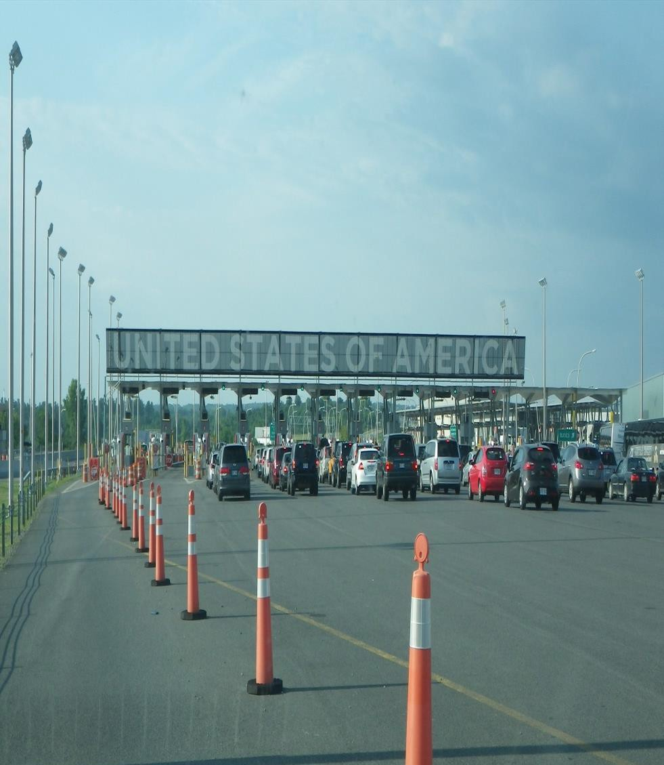
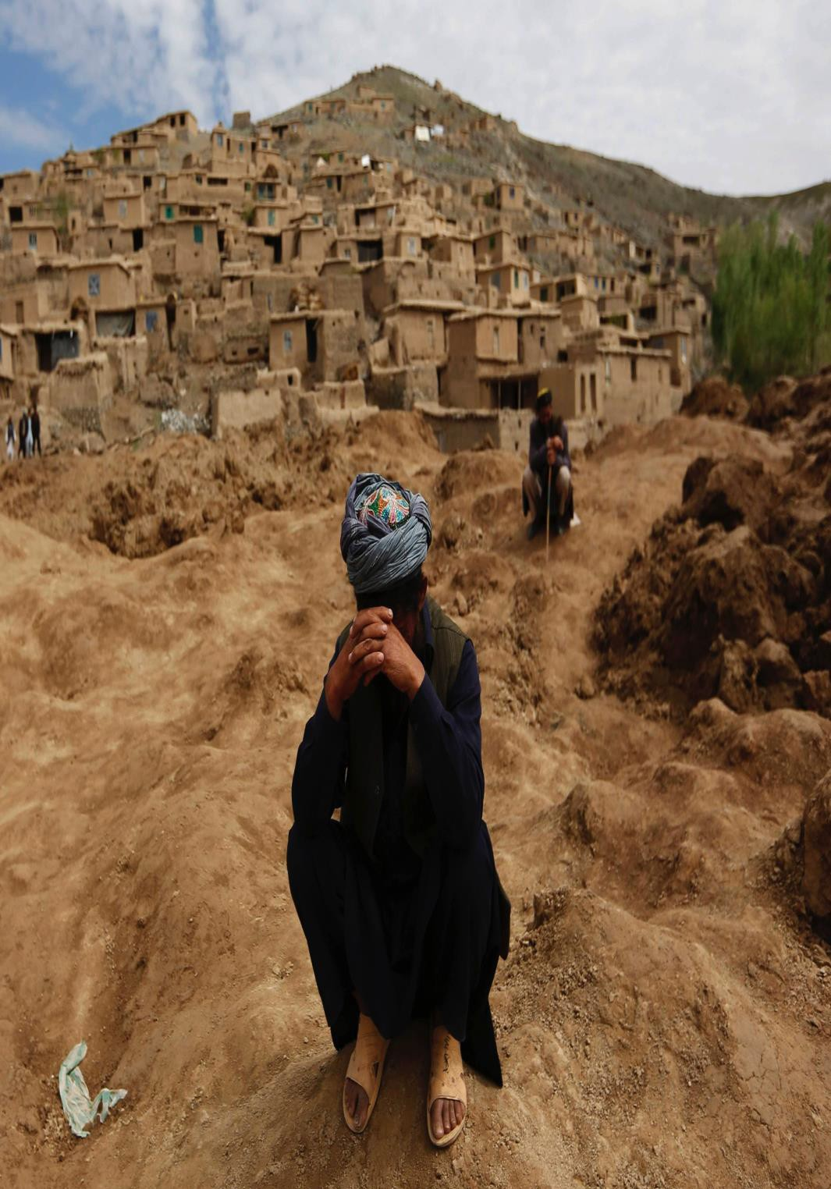
The world is changing fast – even seemingly
local situations, are strategic in nature.

Slide 142

Your path to strategic communications and negotiations is complex and challenging…but very achievable.

Slide 143















The importance of rapport
Application
BRIDGING TRUST
OUT
S
IN
LIMITED RESOURCES
BONDING TRUST
TRIBAL PLACES

Slide 144
Cultural strategic communications
Application
STATUS SOCIETY | CONTRACT SOCIETY
CLAN | INDIVIDUAL
HOSPITALITY | “BOWLING ALONE”
HONOR/SHAME | ACHIEVMENT/GUIL
REVENGE | RULE OF LAW
FEUD | STATE MONOPOLOY ON VIOLENCE
RELATIONSHIPS | TRANSACTIONS
RESTORATIVE JUSTICE (ATONEMENT) | PUNITIVE JUSTICE
STORY | POWER POINT/SOUND BITES
EMOTION/PERCEPTION | LOGIC/REASON
HOW DO I FEEL? (RIGHT BRAIN) | WHAT DO I THINK? (LEFT BRAIN)
SOCIETAL TRAUMA | THE TRUMAN SHOW
BONDING TRUST | BRIDGING TRUST

Slide 145
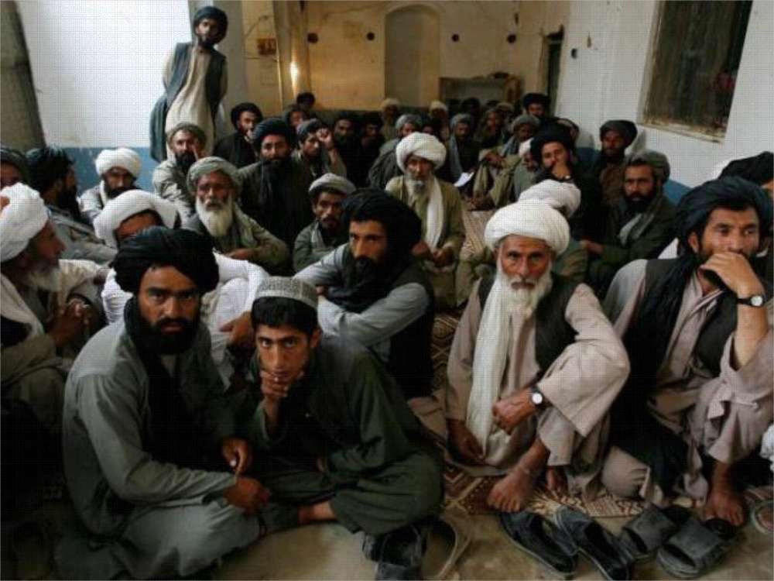
Remember . . . at the end of the day all of our organizations are TRIBAL
Application

